Slide 1

AMBEKESHWAR INSTITUTE OF TECHNOLOGY
& MANAGEMENT, LUCKNOW
Presentation on Industrial Training of Food Ordering Website
Presented By :
Adarsh Ashok Chauhan
Diploma C.S.E.
3rd Year
Submitted To :
Ms. Richa Mishra

Slide 2
Introduction
A digital platform enabling users to browse menus, create accounts, and place food orders online.
It makes the process of ordering food easier and more efficient for customers, while also helping restaurants reach more customers.
Built using HTML, CSS, JavaScript, PHP, and MySQL.
Objective: Simplify the food ordering process by offering:
Centralized platform for browsing and ordering food.
Secure account creation and payment features.

Slide 3
Research Analysis
Market Analysis:
Food delivery websites like Zomato and Swiggy are popular, but they have complex systems.
We focused on building a simple, user-friendly platform.
Objective:
Understand user needs and essential features for an online food ordering platform.
Design Focus:
Simplified navigation, clear menu display, and fast processing.

Slide 4
Designing
Frontend Design:
Used HTML for structure.
Styled the pages with CSS for a clean, attractive look.
Added interactive features using JavaScript
Backend Design:
Used PHP to manage user data, orders, and communication with the database.
Created a MySQL database to store information like user accounts and order details.

Slide 5
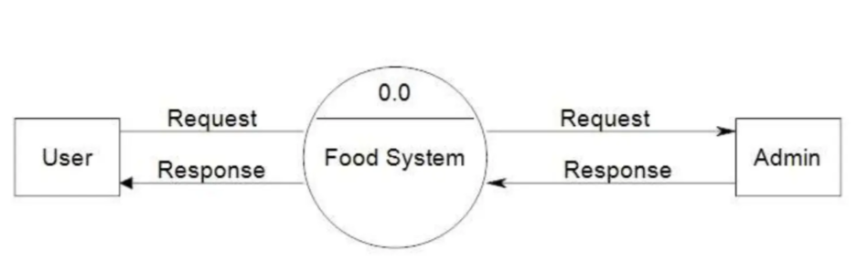
Diagrams:
Data Flow Diagram (DFD)
Fig. Level 0 DFD

Slide 6
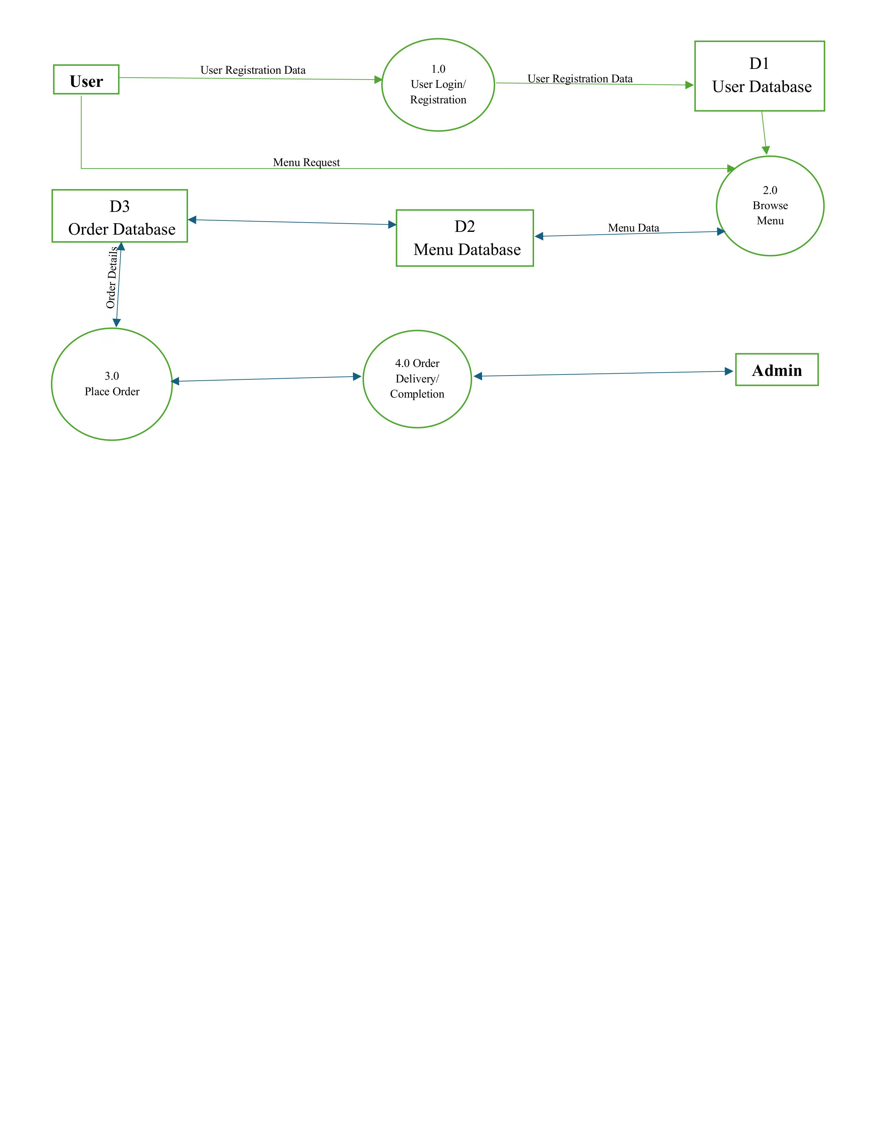



Fig. Level 1 DFD

Slide 7
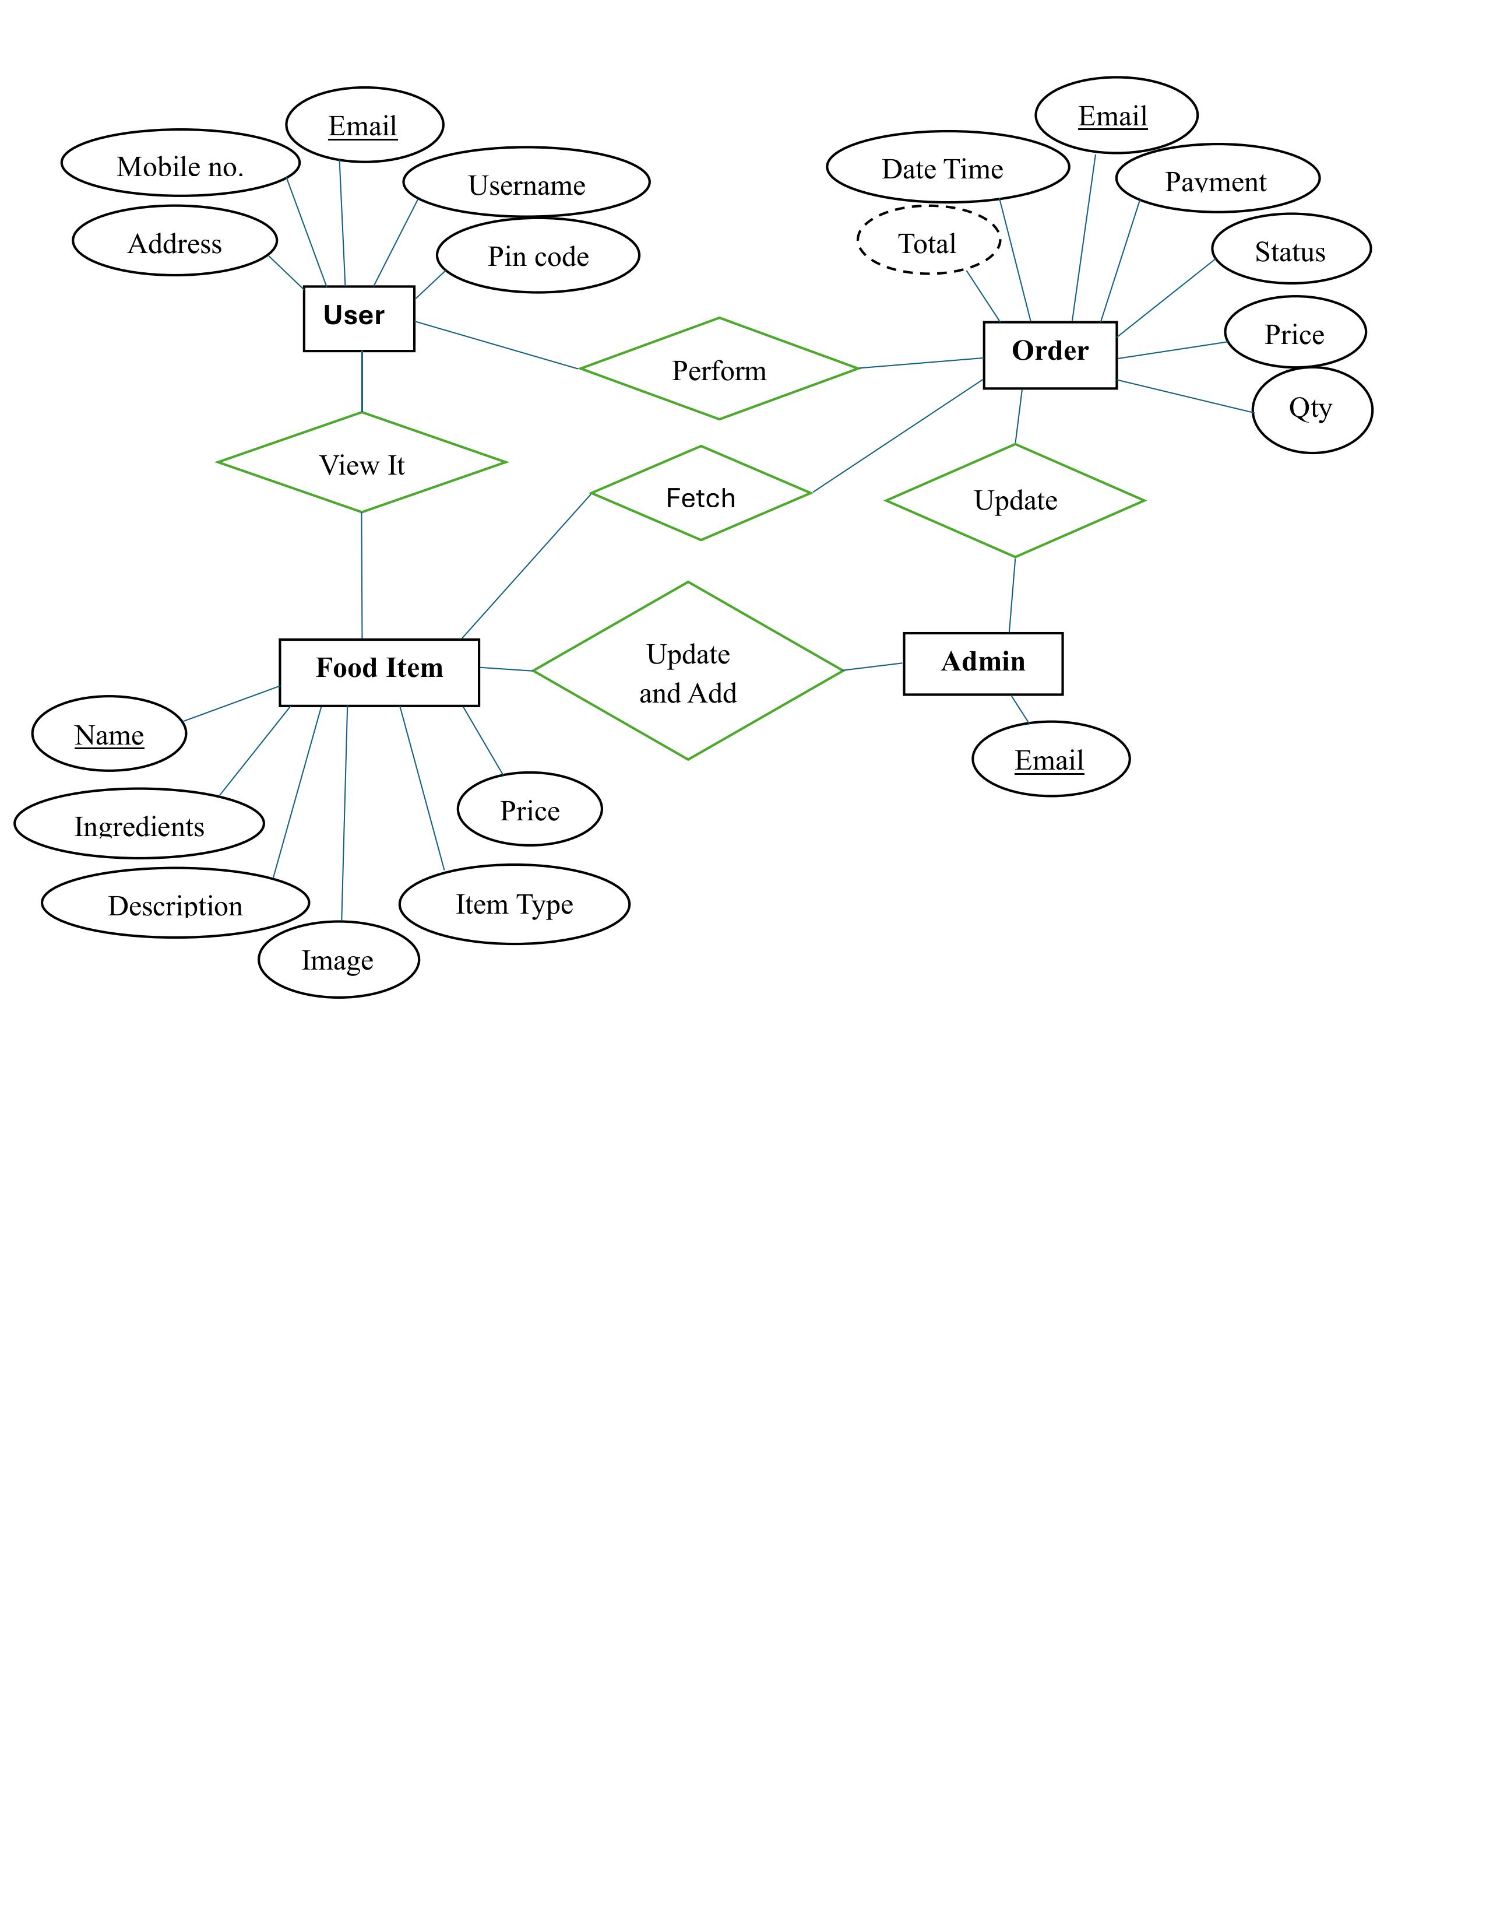
Entity-Relationship (ER) Diagram

Slide 8
Software & Hardware Requirements
Software Used:
Visual Studio Code for writing the code of our website.
XAMPP as a local server to test the website.
Hardware Required:
A computer with 4GB RAM or more than it.
A stable internet connection for research and testing.

Slide 9
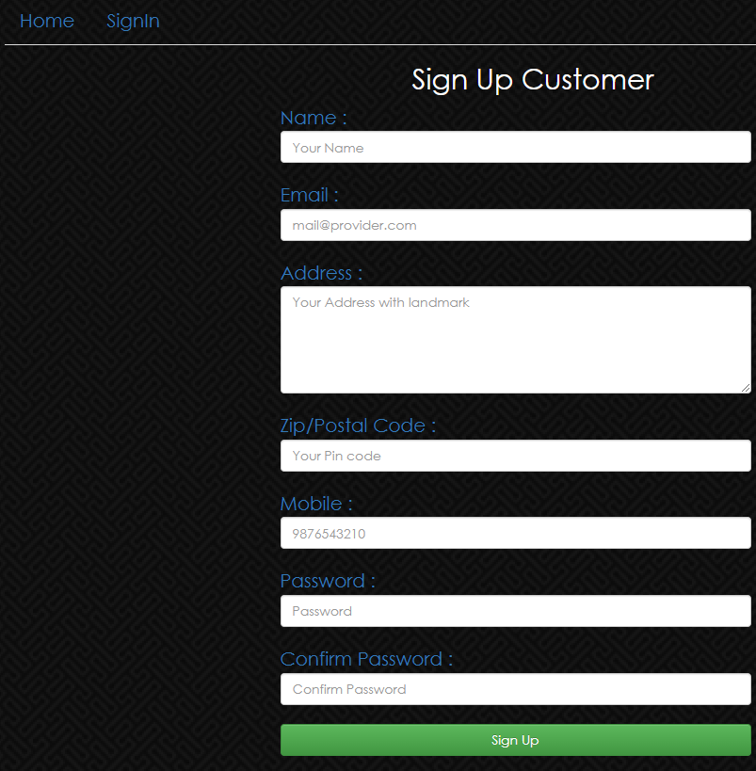
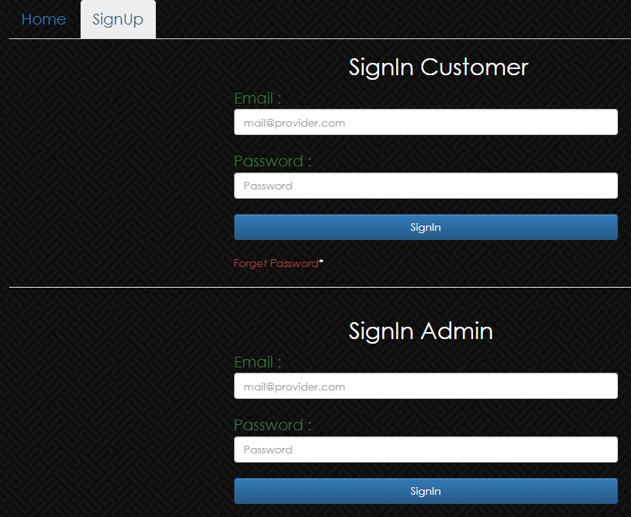
Result
What Was Built?
A food ordering website where users can: order their wise food
Create an account and log in.

Slide 10
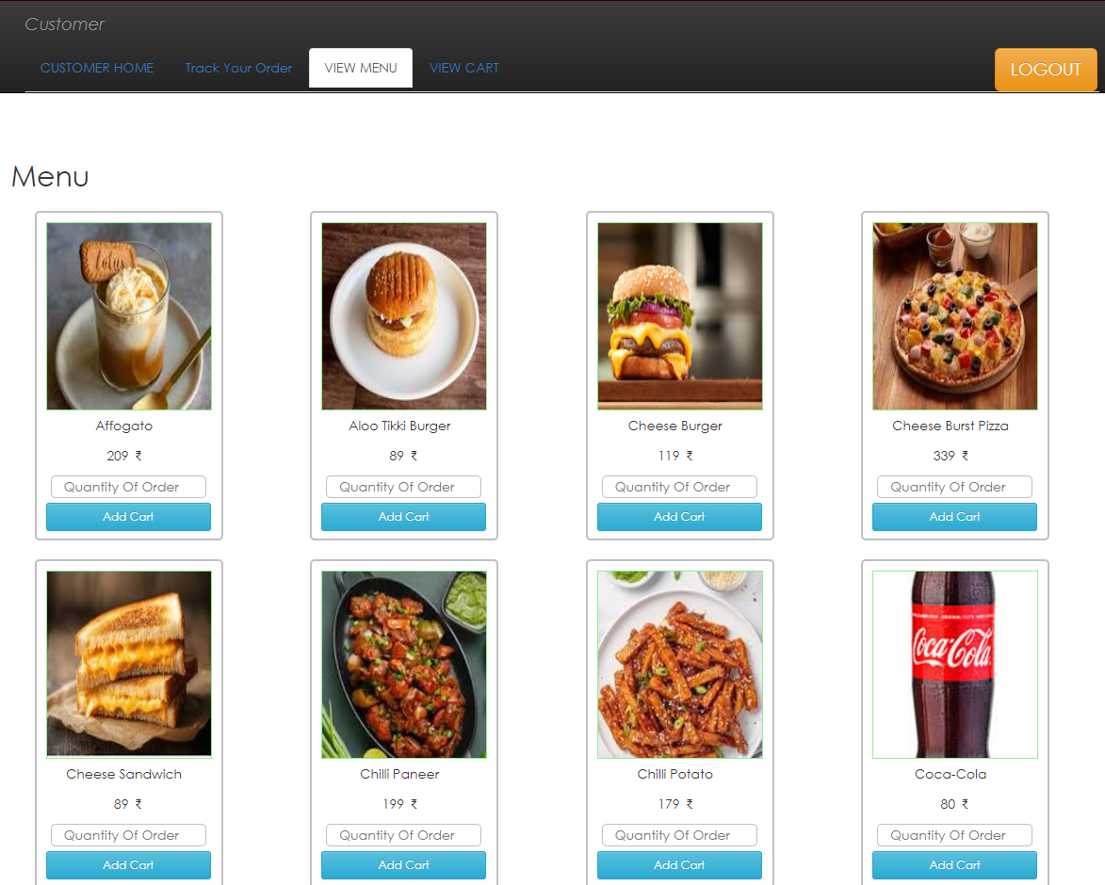
View a menu and select items to order.

Slide 11
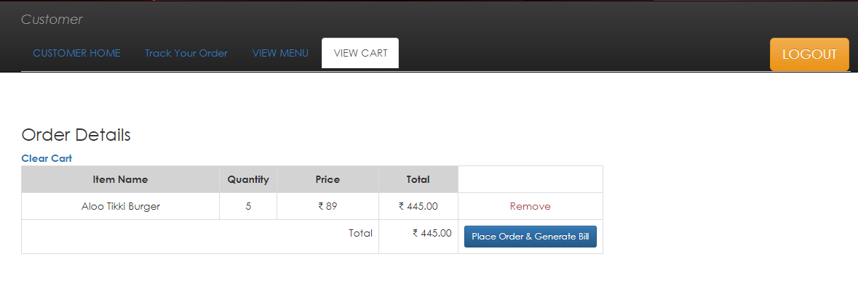
Place orders and view their order history.

Slide 12
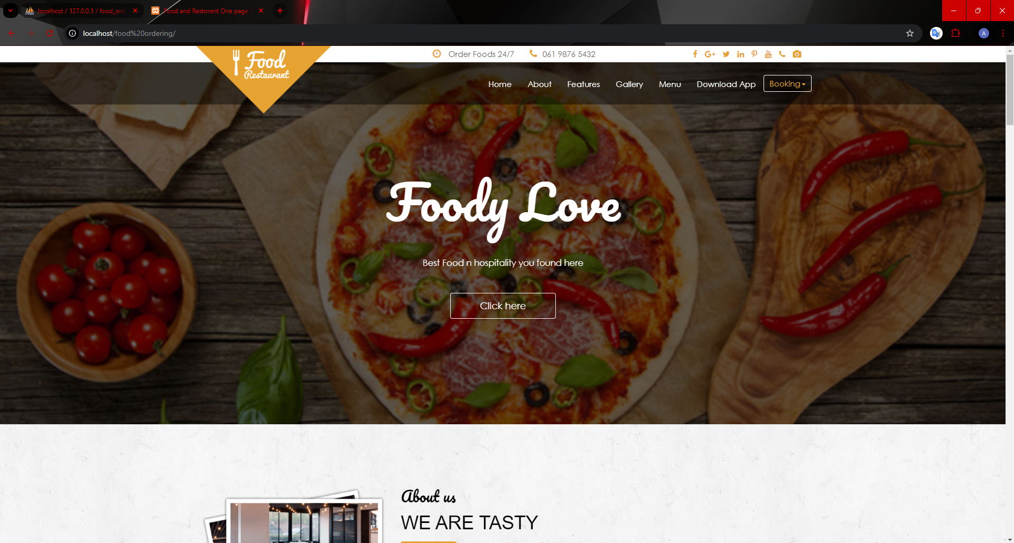
Visuals:

Slide 13
Conclusion & Future Scope
Conclusion:
I learned how to use web technologies to build a functional website.
Gained hands-on experience in both frontend and backend development.
Future Scope:
Add a payment gateway for online payments.
Include real-time order tracking.
Implement advanced search options for the menu.
Make the website mobile-friendly for better user experience.

Slide 14
References
Tutorials and Documentation:
W3Schools for HTML, CSS, and JavaScript basics.
PHP documentation for backend development.
MySQL guides for database management.
Tools Used:
Visual Studio Code
XAMPP for testing and local server setup.
Acknowledgment:
Thanks to my trainer and the organization for their guidance.

Slide 15
THANK YOU

